Slide 1
In Silico Comparison of Photons versus Carbon Ions in Single Fraction Therapy of Lung Cancer
Kristjan Anderle

Slide 2
Outline
Introduction
Normal Lung Cancer Patients
Multiple Tumors Lung Cancer Patients
Conclusion & Outlook

Slide 3
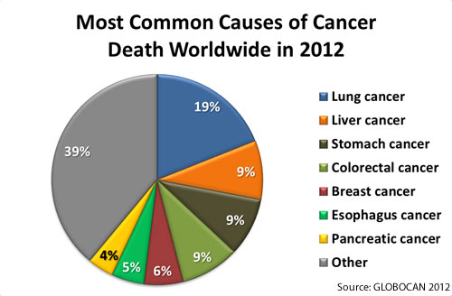
Introduction

Slide 4
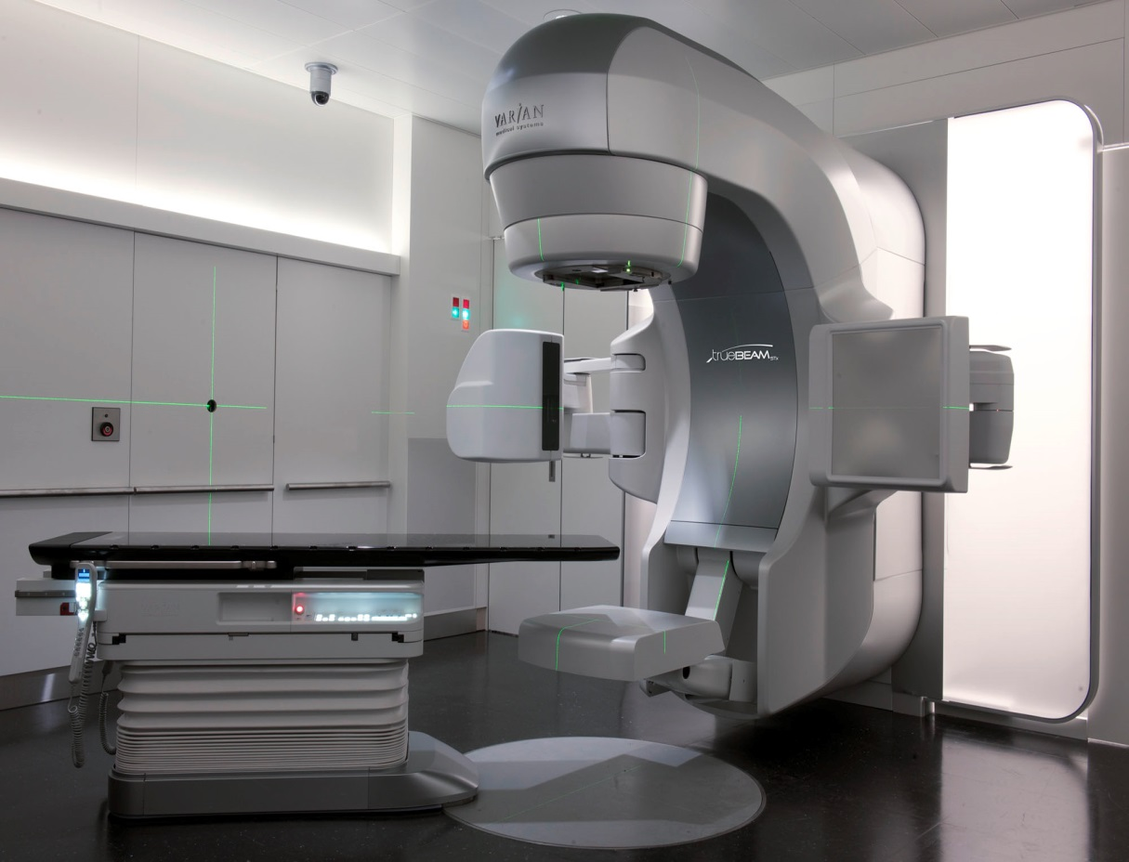
Stereotactic Body Radiation Treatment (SBRT)

Slide 5
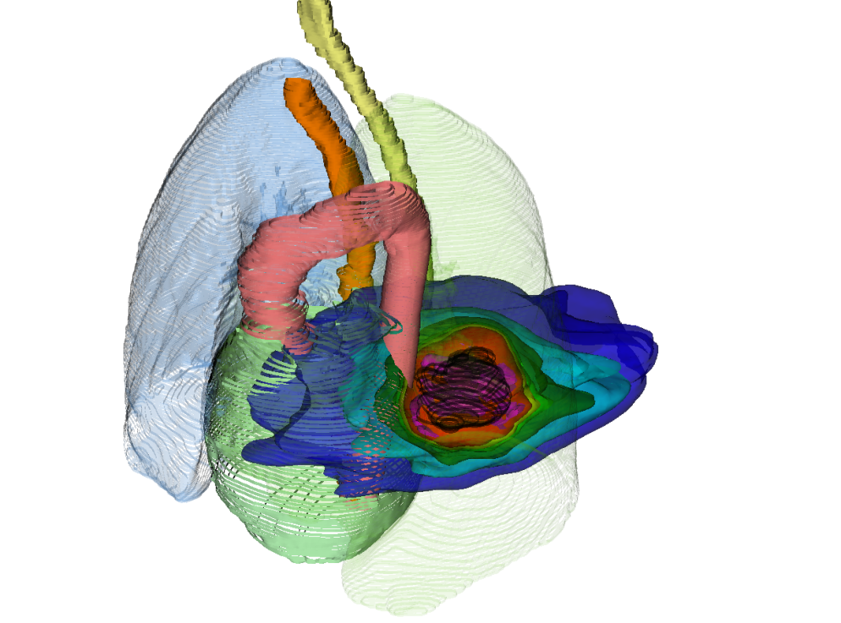
Introduction
photons

Slide 6
Introduction
photons
12C
photons
p+

Slide 7
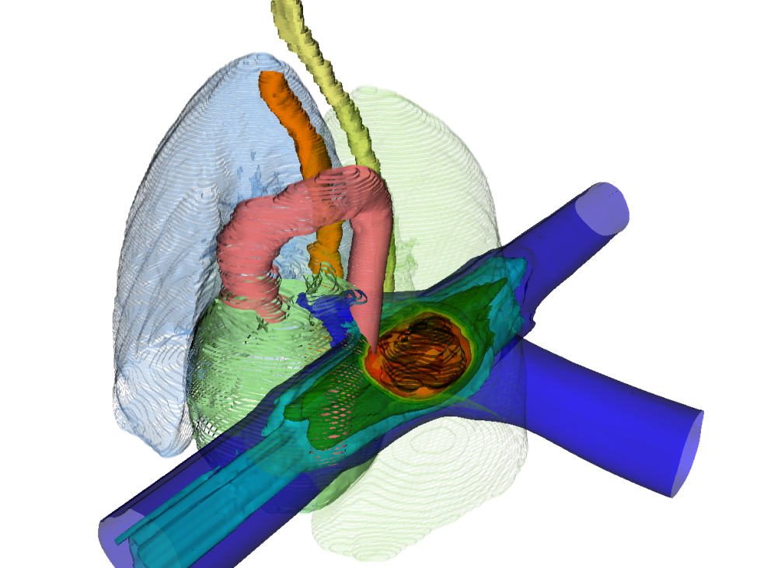
Introduction
photons
LEGENDA!
¹²C
12C
photons
p+

Slide 8
Introduction
PT Raster scanning
PT Bragg peak
PT range changes & interplay

Slide 9
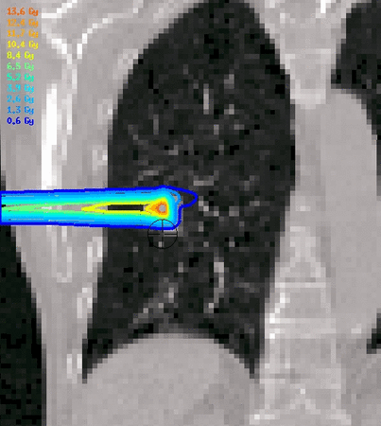
Introduction
PT Raster scanning
PT Bragg peak
PT range changes & interplay
Courtesy M. Söhn, LMU

Slide 10
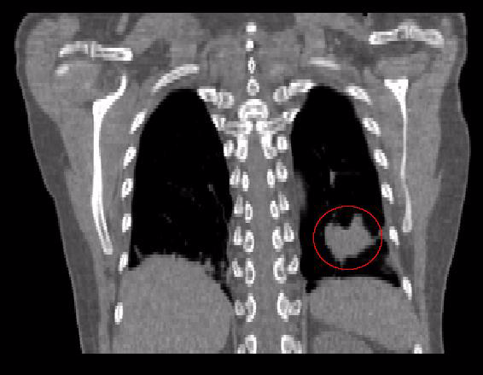
Deformable Image Registration

Slide 11
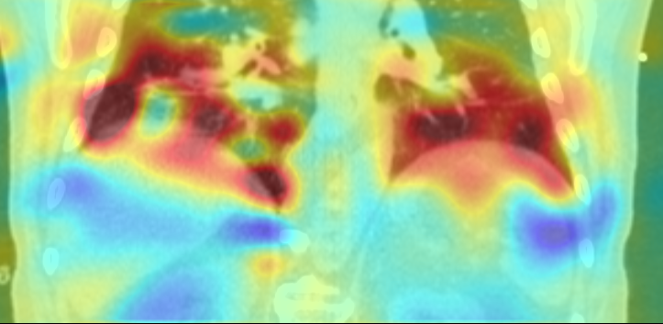
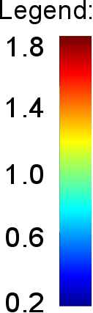
Deformable Image Registration Quality Assurance
Quality assurance with qualitative and quantitative test
Extensive verification, with over 1000 deformable image registrations
Jacobian map of vector field

Slide 12
Outline
Introduction
Normal Lung Cancer Patients
Multiple Tumors Lung Cancer Patients
Conclusion & Outlook

Slide 13
Patient Data
19 patients, 26 tumors
Average tumor volume: 2.9 cm³
Average tumor motion: 3.1 mm

Slide 14
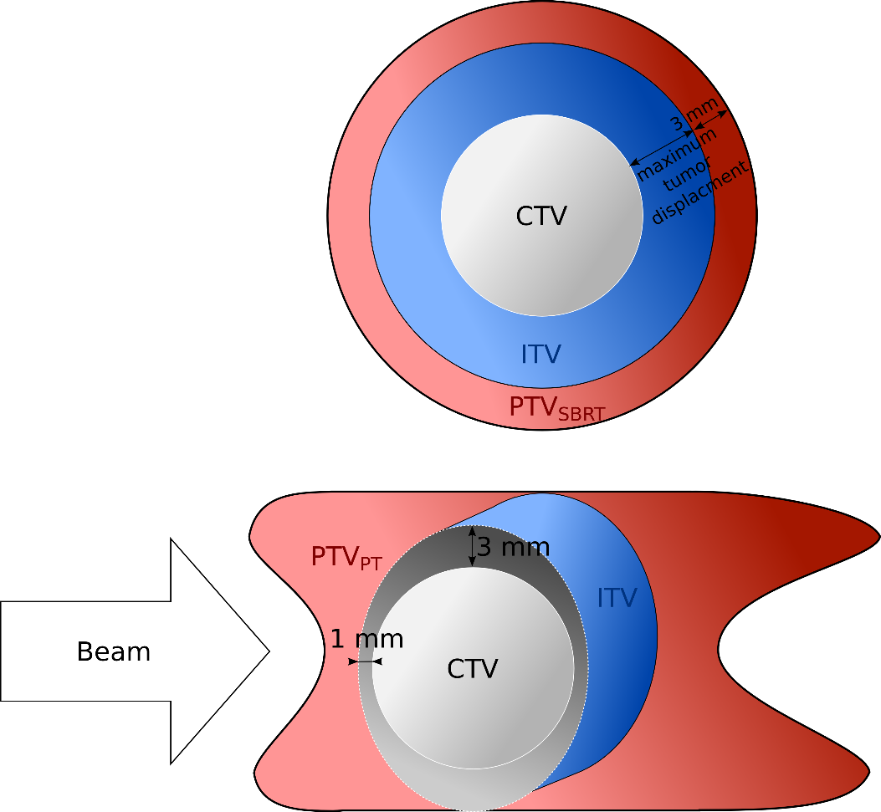
Patient Data – Normal Cases
19 patients, 26 tumors (each tumor 1 x 24 Gy)
Average tumor volume: 2.9 cm³
Average tumor motion: 3.1 mm
Single field uniform optimization
LEM IV biological model

Slide 15
Patient Data – Normal Cases
SBRT single treatment plan
PT 10 dose calculations per patient:
Without motion, static (2x)
With motion, without compensation, 4D-interplay (4x)
With motion, with compensation, 4D-rescanning (4x)

Slide 16
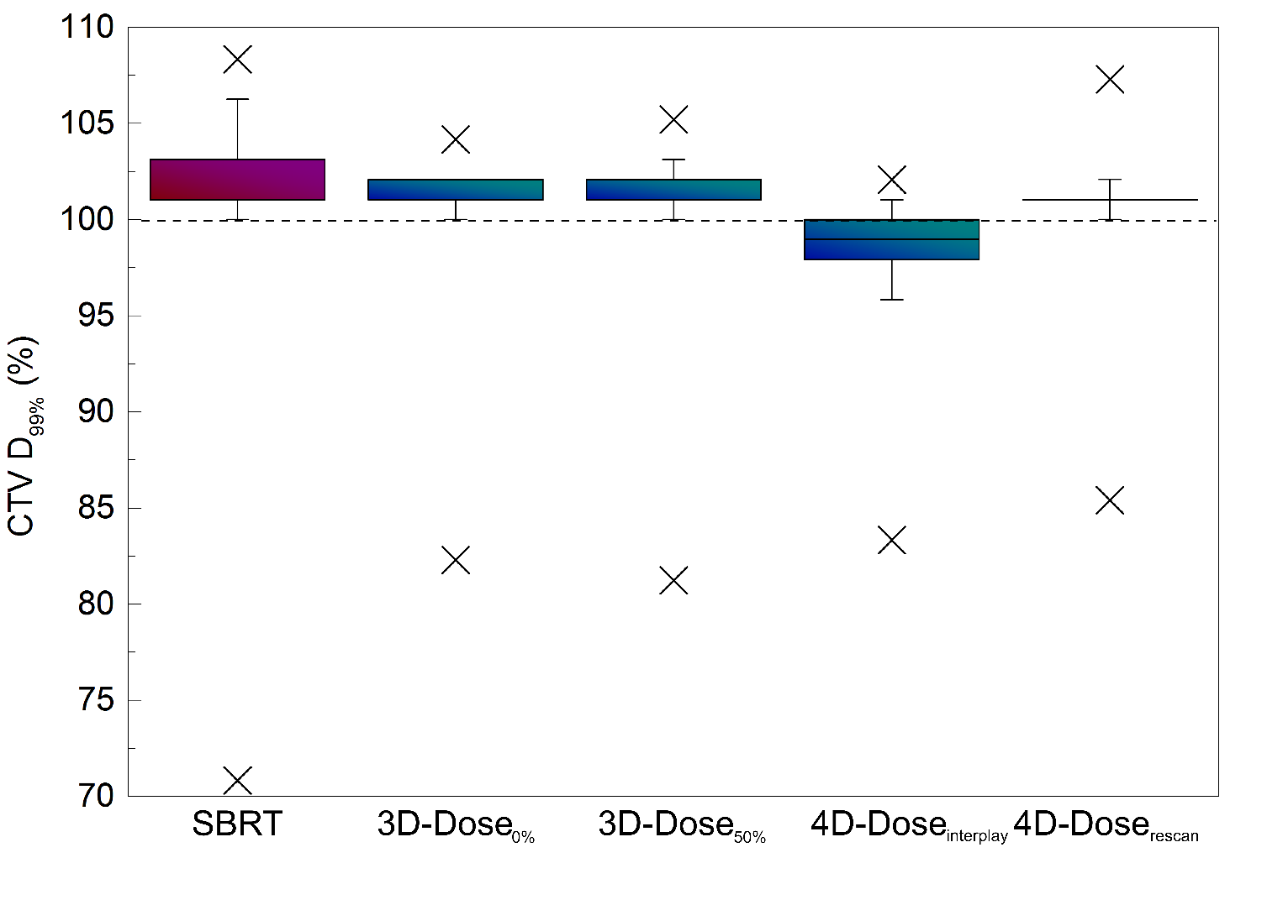
Normal cases – Dose to Tumors

Slide 17
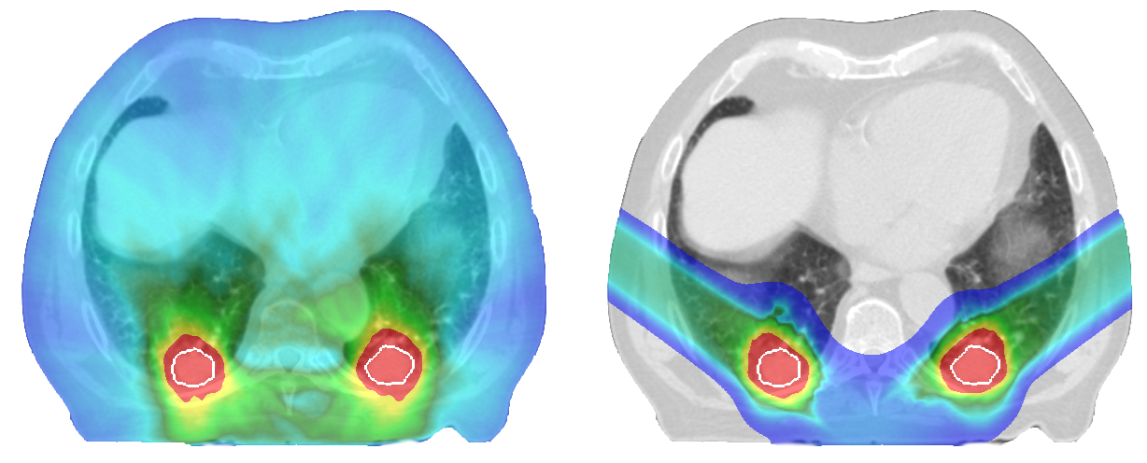
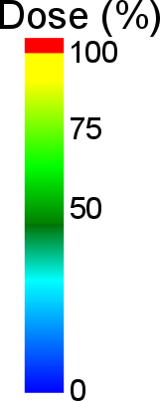
Normal Cases - Example
SBRT
PT

Slide 18
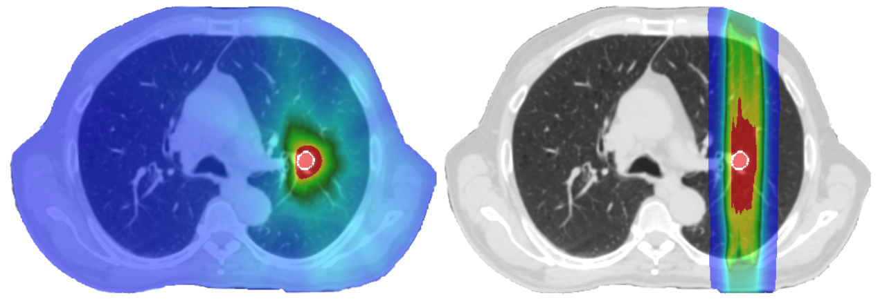
Normal Cases - Example
SBRT
PT

Slide 19
Normal Cases- Dose to Critical Organs

Slide 20
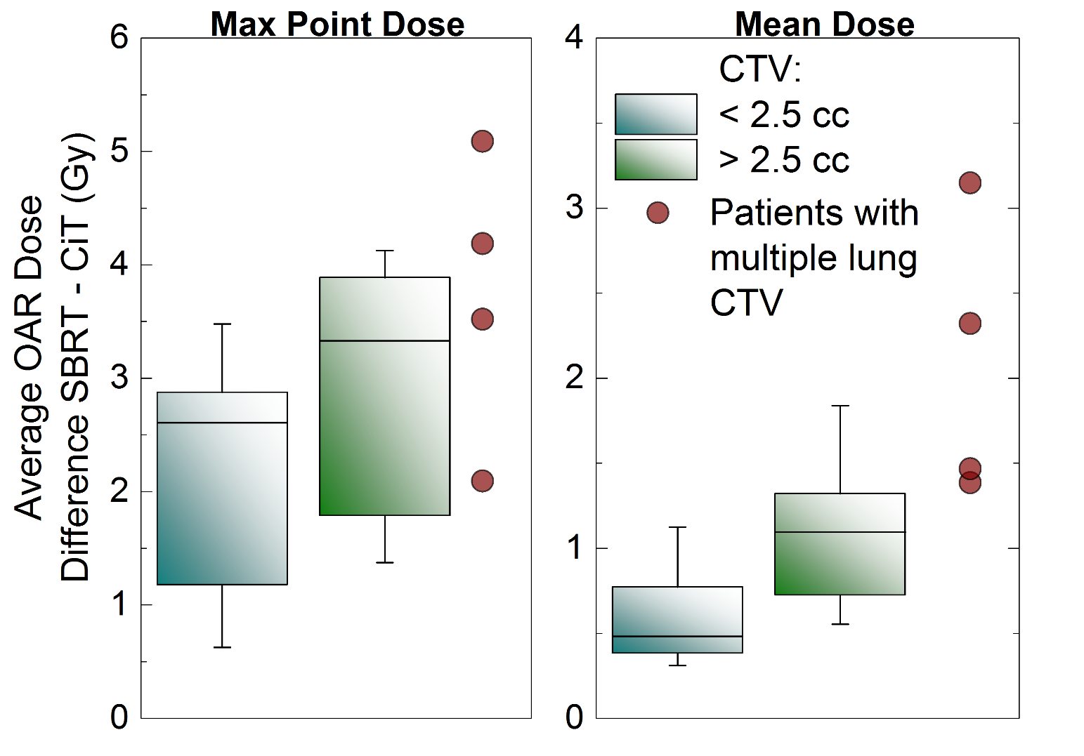
Normal Cases- Dose to Critical Organs

Slide 21
Outline
Introduction
Normal Lung Cancer Patients
Multiple Tumors Lung Cancer Patients
Conclusion & Outlook

Slide 22
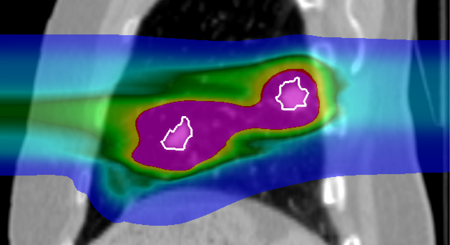
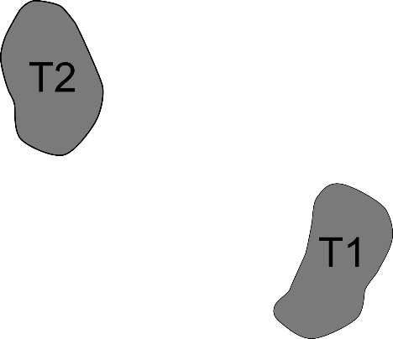
Intensity modulated particle therapy optimization for multiple targets

Slide 23
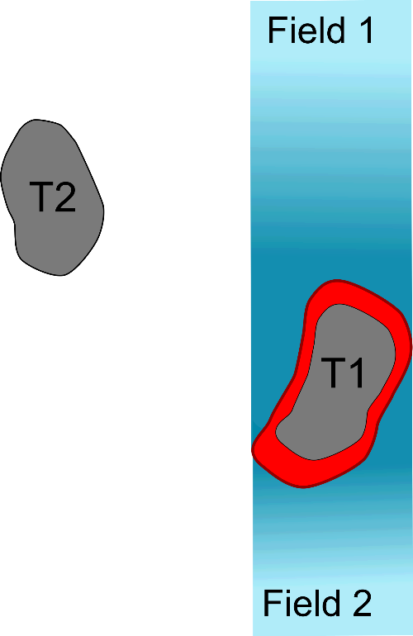
Intensity modulated particle therapy optimization for multiple targets

Slide 24
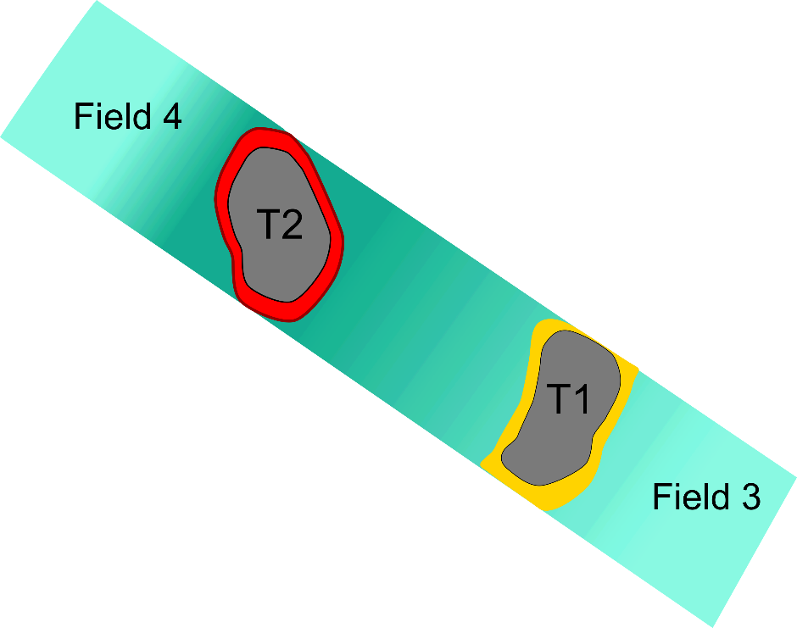
Intensity modulated particle therapy optimization for multiple targets

Slide 25
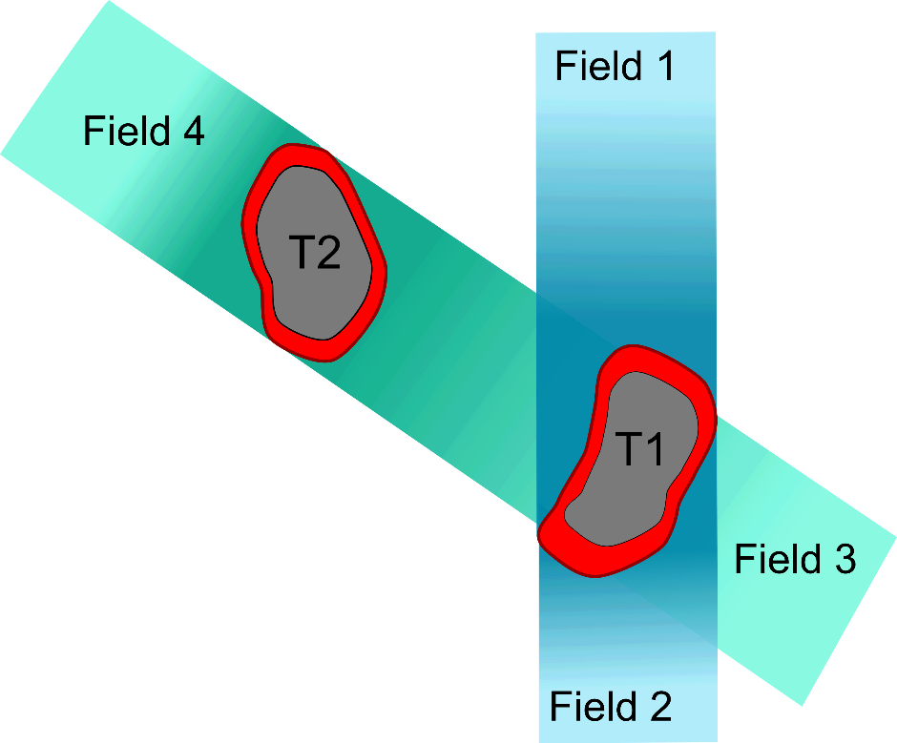
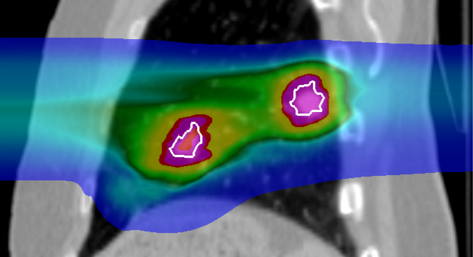
Intensity modulated particle therapy optimization for multiple targets

Slide 26
Patient Data – Multiple Tumors
8 patients, 24 tumors
Average tumor volume: 4.1 cm³
Average tumor motion: 5.9 mm
Several critical organs in close vicinity to the tumor

Slide 27
Patient Data – Multiple Tumors
SBRT single treatment plan
PT 8 dose calculation per patient:
2 optimizations, each 4 breathing patterns
Dose escalation for 3 patients to 1 x 24Gy

Slide 28
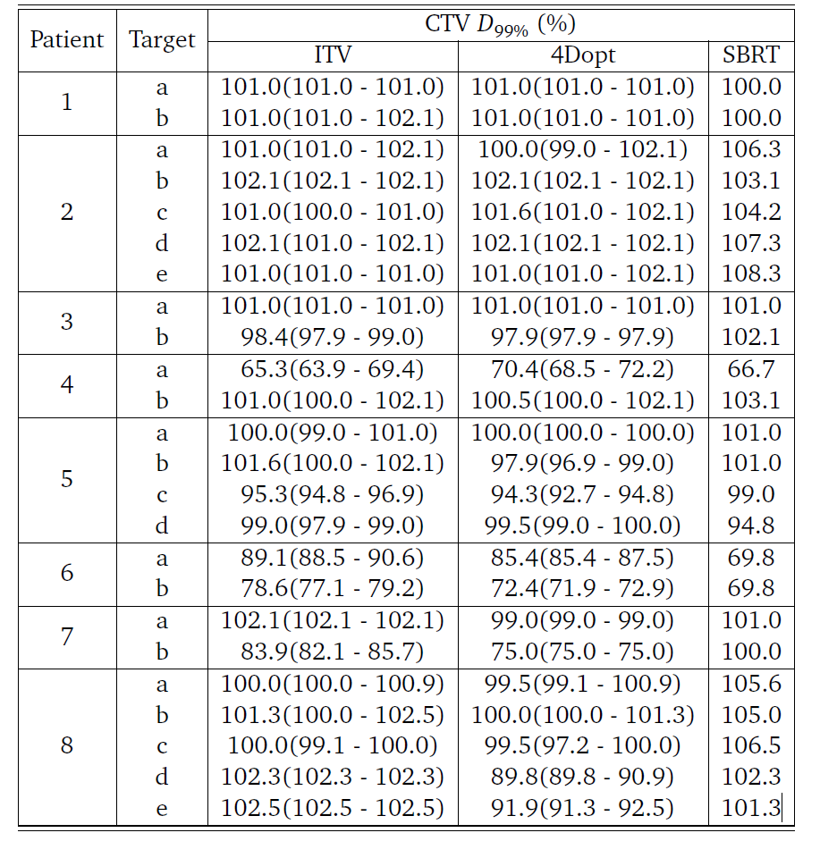
Multiple Tumors – Dose to the Tumors

Slide 29
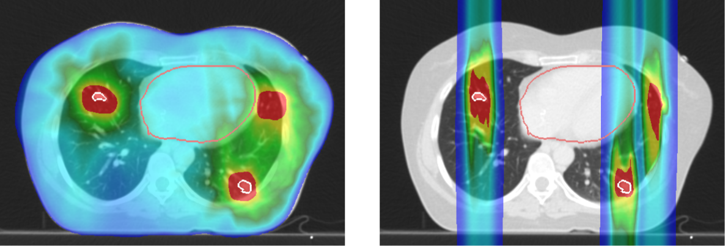
Multiple Tumors - Example
SBRT
PT

Slide 30
Multiple Tumors – Dose to the Tumors

Slide 31
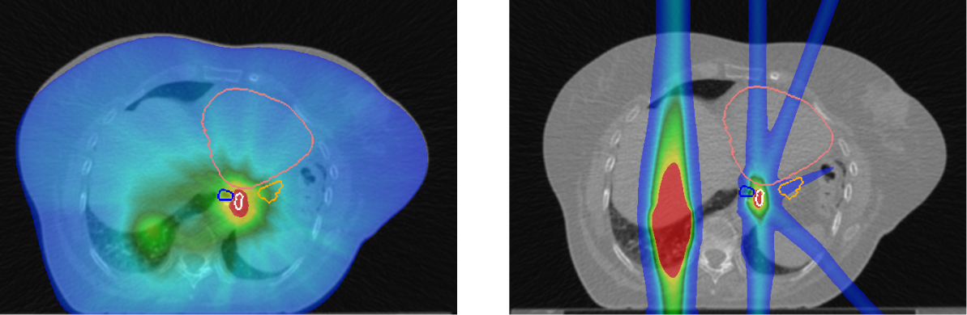
Multiple Tumors - Example
Heart
Heart
Esophagus
Stomach
Esophagus
Stomach
Target
Target
SBRT
PT

Slide 32
Multiple Tumors – Dose to Critical Organs
Figure

Slide 33
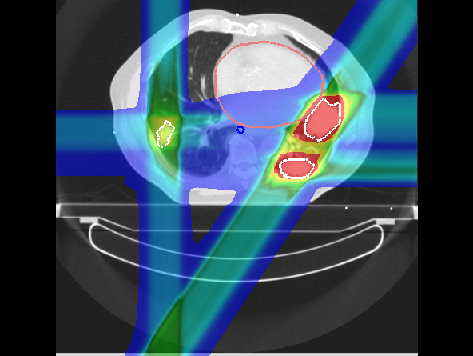
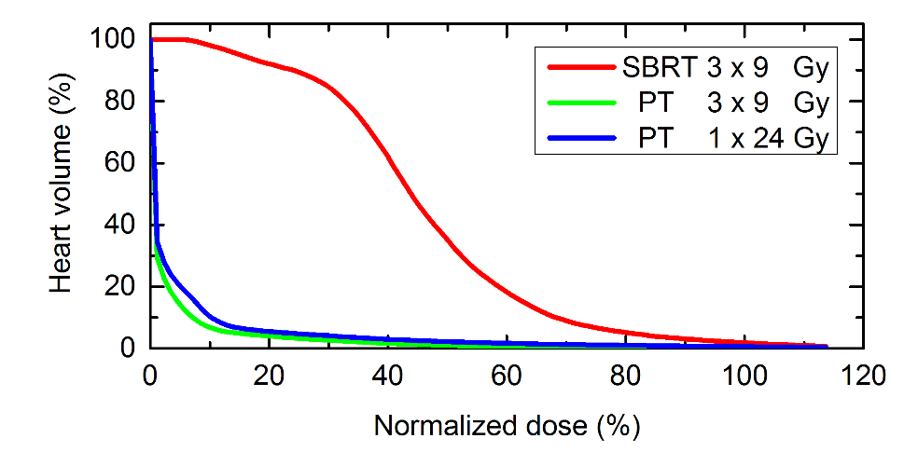
Complex Cases – dose escalation

Slide 34
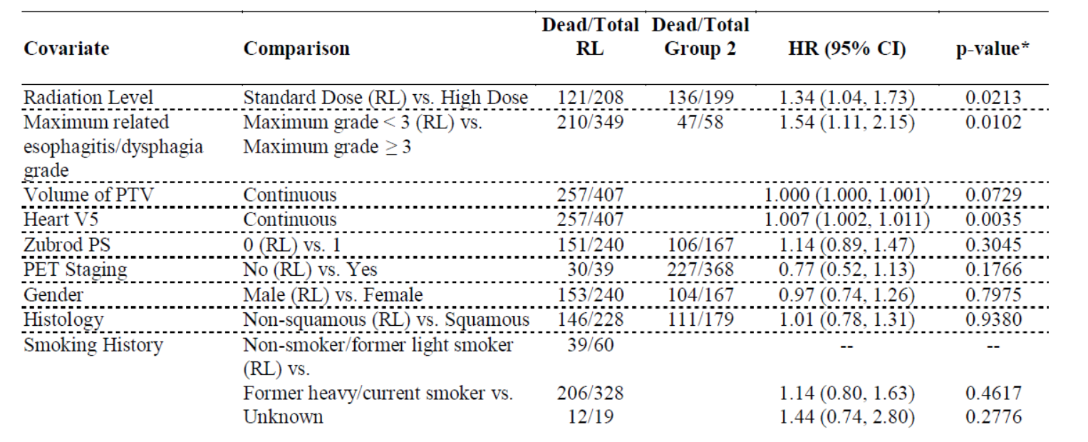
Clinical Trial RTOG 0617

Slide 35
Outline
Introduction
Normal Lung Cancer Patients
Multiple Tumors Lung Cancer Patients
Conclusion & Outlook

Slide 36
Conclusions
PT delivers the same dose to tumors as SBRT,
while depositing significantely less dose to normal tissue.
PT could deliver full ablative dose in single fraction, where SBRT could not
PT should be considered as a treamtent modality for lung cancer patients

Slide 37
Outlook
Phase III Randomized Trial Comparing Overall Survival After Photon Versus Proton Chemoradiotherapy for Inoperable Stage II-IIIB NSCLC (RTOG 1308), started in 2014, passive scattering proton therapy
First lung cancer patients treated with active scanning carbon-ions at NIRS, Chiba (Japan)
Löwe?

Slide 38

Acknowledgments
GSI
C. Graeff
M. Durante
A. Eichorn
M. Prall
S. Hild
FC
J. Stroom
C. Greco
N. Pimentel
S. Vierra
UK Erlangen
C. Bert
T. Brandt
J. Wölfelschneider

Slide 39
Thank you for your attention.

